Slide 1

18ECC205J ANALOG AND DIGITAL COMMUNICATION Course Credit : 4 Theory : 9 Hours Singh. R. P & Sapre. S. D, “Communication Systems: Analog & Digital,” 3rd edition, McGrawHill Education, Seventh Reprint, 2016. Simon Haykin, “Communication Systems”, John Wiley & Sons, 4th Edition, 2008.
Communication Systems, CASE
1

Slide 2
Unit 1 Week 1 Session 1: Modulation, Need for Modulation, Amplitude Modulation Session 2: Types of Amplitude Modulation ,DSBFC Session 3: DSBSC,SSBSC,VSB Reference Books Singh. R. P & Sapre. S. D, “Communication Systems: Analog & Digital,” 3rd edition, McGrawHill Education, Seventh Reprint, 2016.

Slide 3







UNIT I: What are we studying?
Communication Systems, CASE
Analog Modulation
Base Band Modulation Schemes
Amplitude Modulation DSBFC
DSBSC, SSBSC, VSB
Angle Modulation
FM, PM
3

Slide 4
Communication Systems, CASE
What is Communication?
Communication is a process of conveying or transferring message or information from one place to another place.
Examples of messages : Audio signals in speech transmissions, Picture (Video) signals in television transmissions and data (say text) signals in data transmission.
Types
. Line communication
. Radio communication
4

Slide 5
Block Diagram of Communication System
Communication Systems, CASE
5

Slide 6
Communication Systems, CASE
The communication system consists of three basic components.
1.Transmitter 2.Transmission media 3.Receiver
Transmitter is the equipment which converts physical message, such as sound, words, pictures etc., into corresponding electrical signal.
Receiver is an equipment which converts electrical signal back to the physical message.
Channel may be either transmission line or free space, which provides
transmission path between transmitter and receiver.
6

Slide 7
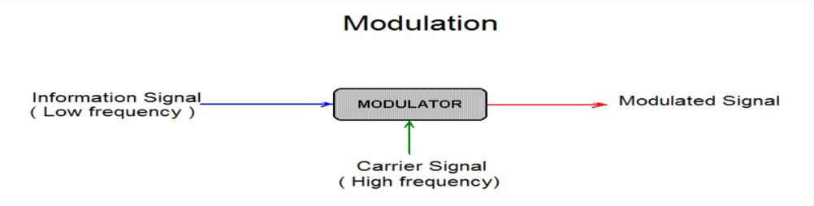
Modulation: Modulation is defined as the process by which some characteristics (i.e. amplitude, frequency, and phase) of a carrier is varied in accordance with instantaneous value of modulating signal
Communication Systems, CASE
Carrier Signal : High frequency signal to carry the message. Its frequency will be in the range of MHz.
Message/ Modulating Signal : Contains the information to be transmitted. Its frequency will be in the range of 20Hz to 20KHz.
Demodulation is the reverse process of modulation, which is used to get back the original message signal. Modulation is performed at the transmitting end whereas demodulation is performed at the receiving end.
7

Slide 8


NEED FOR MODULATION
Communication Systems, CASE
Multiplexing-It helps in transmitting a number of messages simultaneously over a single channel and therefore the number of channels needed will be less. This reduces the cost of installation and maintenance of more channels. If transmitted without modulation,the several message over a single channel will interfere with one another.
Practicability of antenna - To reduce antenna height.
If f=5KHz, then height of the antenna
If f=10MHz, then height of the antenna
=15m
3.Narrowbanding
7

Slide 9
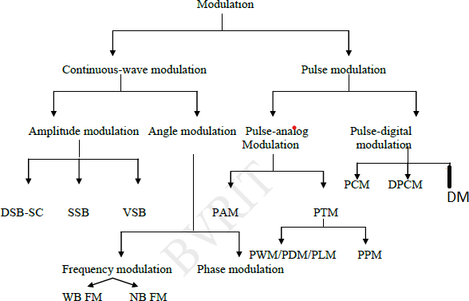
Types of Modulation
Communication Systems, CASE
8

Slide 10
AMPLITUDE MODULATION
Communication Systems, CASE
A modulation process in which amplitude of the carrier signal is varied in accordance with instantaneous value of the modulating signal is known as amplitude modulation.
Representation of Amplitude modulated signal:
Carrier signal is mathematically denoted as e(t) = E_{c} cosω_{c}t,
E_{c} = Amplitude of the carrier signal, ω_{c} = angular frequency of the carrier signal(rad/sec).
Modulating signal is mathematically denoted as f(t) = E_{m}cos⍵_{m}t,
E_{m} = Amplitude of the carrier signal, ⍵_{m} = angular frequency of the carrier
signal(rad/sec).
After AM, Amplitude of carrier signal ,E_{c} = E_{c} + f(t)
eAM(t) = [E_{c} + f(t)] cosω_{c}t _{, eAM}
(t) = E_{c} cosω_{c}t+ f(t ) cosω_{c}t
carrier sidebands
9

Slide 11
Communication Systems, CASE
Substitute f(t) = E_{m}cos⍵_{m}t
eAM(t) = E_{c} cosω_{c}t+ E_{m}cos⍵_{m}t cosω_{c}t
= E_{c} cosω_{c}t(1+ E_{m}/E_{c} cos⍵_{m}t )
Modulation index, E_{m}/E_{c} = m_{a} (Ratio of modulating voltage to carrier voltage)
eAM(t) = E_{c} cosω_{c}t(1+ m_{a} cos⍵_{m}t )
eAM(t) = E_{c} cosω_{c}t+ m_{a} E_{c} cosω_{c}t cos⍵_{m}t , Apply cos A cos B formula, Then we get
eAM(t) = E_{c} cos⍵_{c}t + m_{a} E_{c}/2 [cos(⍵_{c}+⍵_{m} )t + cos (⍵_{c}- ⍵_{m} )t]
Carrier signal USB LSB
eAM(t)=Amplitude modulated signal

Slide 12
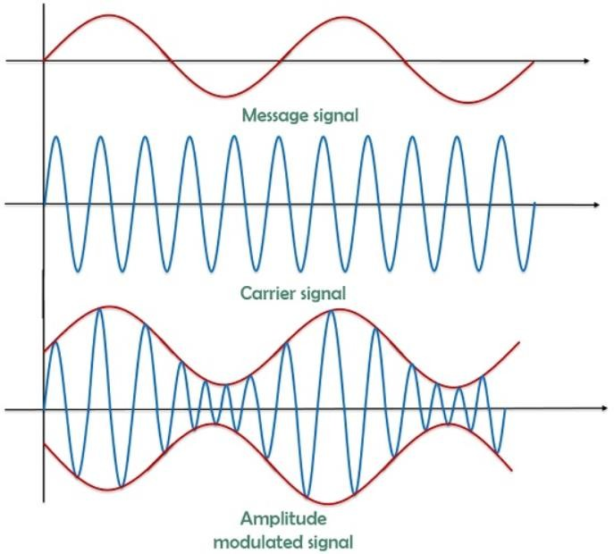
Time domain representation of DSB-FC
Communication Systems, CASE

Slide 13
Frequency Spectrum of DSB -FC
Communication Systems, CASE
Bandwidth = Highest frequency – Lowest frequency
= ( fc + fm) - ( fc - fm) = 2f_{m}
Ec
maEc/2
maEc/2
f_{c}-f_{m} LSB
f_{c}
f_{c}+f_{m} USB
f
BW=2f_{m}
12

Slide 14
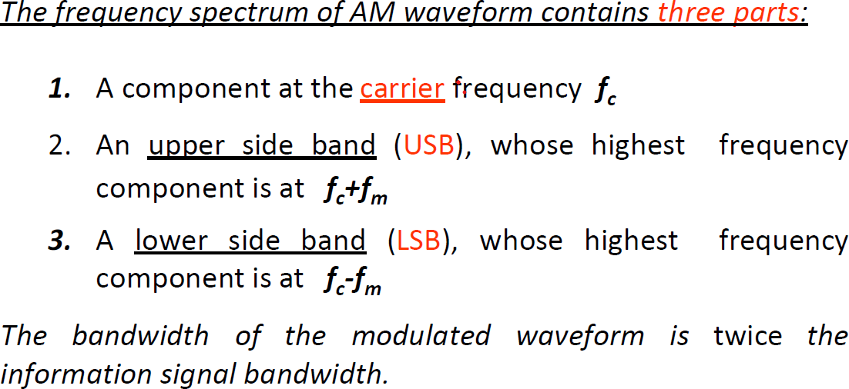
Frequency spectrum of DSB FC
Communication Systems, CASE

Slide 15
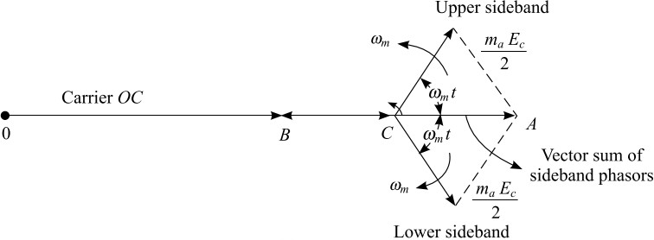
Phasor Diagram of DSB FC

Slide 16
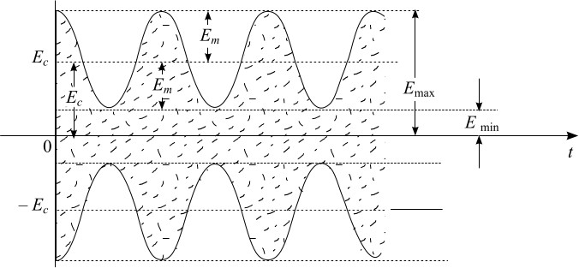
Waveform of DSB FC
Communication Systems, CASE

Slide 17
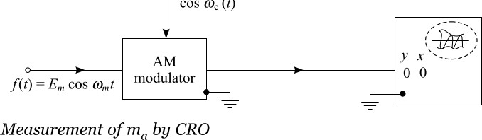
Measurement of ma by CRO
Communication Systems, CASE

Slide 18
Measurement of m_{a} by CRO
Communication Systems, CASE
From the Waveform of DSB FC
E_{m}=E_{max}- E_{c}=E_{c}- E_{min}
^{2E}m^{=E}max^{- E}min
E_{m} = (E_{max}- E_{min} ) /2
E_{c}=E_{max}- E_{m}=E_{min}+E_{m}
E_{c}=E_{max}-[(E_{max}- E_{min} )/2]=( E_{max}+ E_{min} ) /2
m_{a} =Em/Ec
m_{a} =(E_{max}-E_{min})/(E_{max}+E_{min})

Slide 19
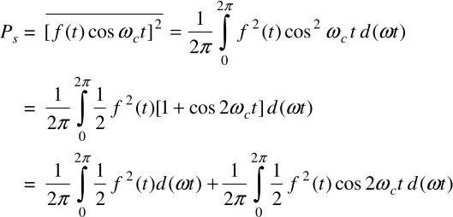

Total Radiated Power and Current of DSB FC
Communication Systems, CASE
eAM(t) = A cosω_{c}t+f(t) cosω_{c}t A=Amplitude of carrier signal
carrier sidebands
Carrier power(Pc ):
Pc= = A²/2 = Mean square value of modulating signal
Side band power (P_{S}) :
.
The second integral is filtered out by BPF centered around ω_{c} .
P_{S}=
P_{S}= P_{LSB}+P_{USB} =Em²/4
Total Radiated Power:
, = Mean square value of modulating signal
P = Pc + P_{S ,} E_{m}/E_{c} =m_{a}
18

Slide 20

Total Radiated Power and Current of DSB FC
E_{m =} m_{a} A
Side band power
2 2
P_{S}= m_{a} A /4
Total power P = Pc+P_{S}
2
P= Pc+ m_{a} P_{c}/2
2
=P_{c} [1+(m_{a} /2)]
P =1.5P_{c}
Total current I = I_{c}
m_{a} =1 for Critical modulation

Slide 21
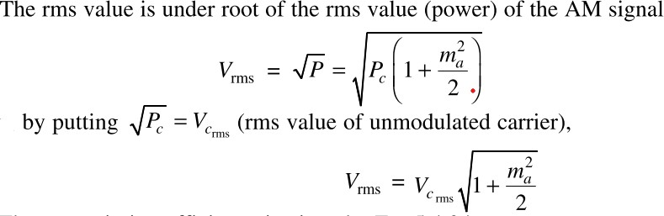
rms value of Modulating Signal
Communication Systems, CASE
rms value:

Slide 22
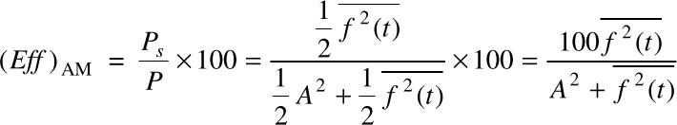


Transmission Efficiency
Communication Systems, CASE
The amount of useful message power Ps present in AM is expressed by a term called transmission efficiency denoted by Eff.It is defined as percentage of total power contributed by the sidebands.
Efficiency =
Dividing numerator and denominator by A²/2 We get,
Eff = m_{a}²/(2+ m ² ) we know Em/A = ma
a
m_{a} =1 , 100% modulation or Critical modulation Eff = (1/3) x100 =33.3%

Slide 23
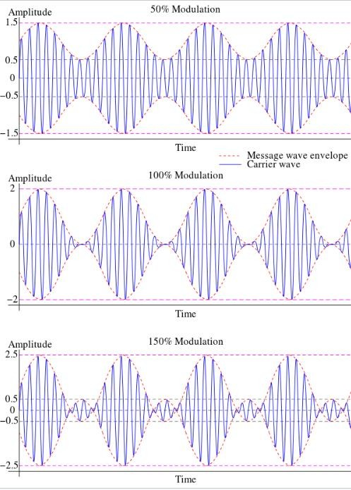
Different types AM with respect to modulation index ma
Communication Systems, CASE
ma <1 Under modulation
ma =1 Critical modulation
ma > 1 Over modulation
Practically,we prefer under modulation condition only.That is ma <1.Em<Ec
22

Slide 24


Types of Amplitude Modulation
Communication Systems, CASE
1.DSB SC (Double Sideband Suppressed Carrier)
2.SSB SC (Single Sideband Suppressed Carrier)
3.VSB (Vestigial Side Band modulation)
1.Reprsentation of DSB SC (Double Sideband Suppressed Carrier)
Product Modulator
cosω_{c}t
f(t) e_{DSB-SC}(t)= f(t) cosω_{c}t
f(t) = cos⍵_{m}t
e_{DSB-SC}(t)= cos⍵_{m}t cosω_{c}t = 1/2[cos(⍵_{c}+⍵_{m} )t + cos (⍵_{c}- ⍵_{m} )t] ,It contains only two sidebands .There is no separate carrier signal.
Bandwidth BW= ( fc + fm) – (fc - fm) =2f_{m}
% of power saving =(P –PS)/P = 66.67%, Transmission efficiency =100%
23

Slide 25




SSB-SC
Communication Systems, CASE
Filter method for generating SSB-SC
cosω_{c}t
f(t)
e_{DSB-SC}(t)= f(t) cosω_{c}t
f(t) = cos⍵_{m}t
The output of Product modulator is given by
e_{DSB-SC}(t)= cos⍵_{m}t cosω_{c}t, It contains only two sidebands .
BPF will be used to eliminate one of the sidebands. So e_{SSB-SC}(t) contains only one sideband either USB or LSB.
e_{SSB-SC}(t) = cos (⍵_{c}- ⍵_{m} )t only Lower sidebands in this case based on tuning of BPF
BW= fc - ( fc-fm) = f_{m}
% of power saving =83.33%, Transmission efficiency =100%
24

Slide 26


Communication Systems, CASE
VSB
In Vestigial sideband modulation, the desired sideband is allowed to pass completely. Whereas just a small portion of the undesired sideband is also allowed. The transmitted vestige of the undesired sideband components for the loss of the desired sideband. Mainly used for Television(TV) signal transmission.
Generation of VSB signal using filter method
cosω_{c}t
f(t)
Η(ω)
VSB
DSB-SC

Slide 27
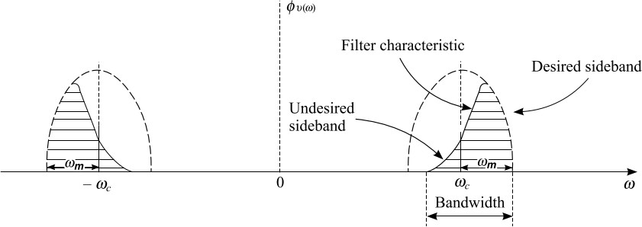
VSB Filter Characteristics
Communication Systems, CASE

Slide 28
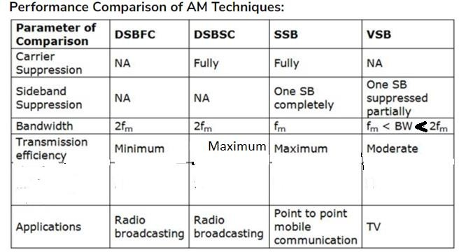
Comparison of Different Amplitude modulation Techniques
Communication Systems, CASE

Slide 29
Frequency spectrum of DSB-SC&SSB-SC
Communication Systems, CASE
Ec
maEc/2
maEc/2
DSB-SC
f_{c}-f_{m}
f_{c}
Ec
f_{c}+f_{m}
f
maEc/2
maEc/2
SSB-SC
f_{c}-f_{m}
f_{c} f_{c}+f_{m}
f

Slide 30
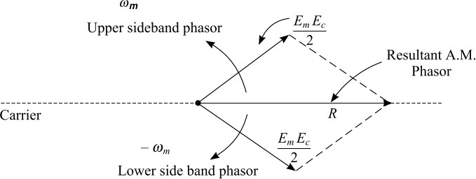
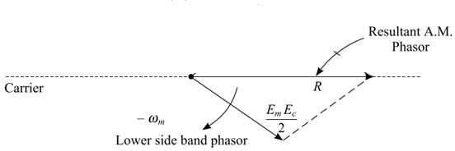
Phasor Diagram of DSB-SC&SSB-SC
Communication Systems, CASE

